Slide 1
Communication & Network Security
(CNS) Code: EC6112
Semeste: 6th
Branch:E&CSc

Slide 2
Course Outcomes
Course Outcome: At the end of the course, the students will be able to :
CO1. Analyze different security threats and attacks with reference to ISO/OSI model security.
CO2. Differentiate between various cryptography, watermarking, steganography methods.
CO3. Analyze different Symmetric and Asymmetric cryptographic algorithms.
CO4. Differentiate various key distribution and Digital Signature.
CO5. Analyze the working of various communication security protocols with respect to OSI layer.
CO6. Analyze different network security systems implementation in Wireless systems.

Slide 3
Syllabus
Prerequisite: Data Communication and Networking (EC 3028)
Introduction: Cryptography, Watermarking, Steganography, Escrow & Crypt Analysis, ISO/OSI reference model & security, Security threatening attacks & actions, Reviews of mathematical foundations (Logarithms, Prime Number, GCD, Groups, Rings, Fields, Fermat’s Theorem, Euler’s Theorem, Exclusive-Or, Random Numbers).
Ciphers &Algorithm: Symmetric Ciphers, Asymmetric Ciphers systems, Elliptic Curve Crypto systems, RSA A

Slide 4
Syllabus
Cryptographic Key distribution system:Key Distribution, Merkle’s Puzzle Method, Shamir’s Key Distribution Method, Digital Signature.
Communication Security layer classification: A synergistic security frame work, Firewalls & Gateways, Security Cross- portfolios, attacks and security in the internet, TACACS.
Network security: Wireless system: WLAN security, IEEE 802.11i robust security network and vulnerabilities, GSM Security, B3G/4G Security Concerns, Wimax Security, and Communication Satellite network security, Wireless Adhoc Network Security.

Slide 5
Text Books
Text Book
1. Cryptography & Network Security by B A Forouzan and D Mukhopadhyay, Mc-Graw Hill, India, 2ndEdition, 2010.
2. Security of Information and Communication Network by S V. Kartalopoulos, Wiley-IEEE Press., 2009.
Reference Book
1. Handbook of Information and Communication Security by Stavroulakis, Peter; Springer, 2010
2. Secure Broadcast communication in Wired and Wireless Communication. By Adrian Perrig& Doug Tygar, Kluwer Publication, 2002.
3. Modern Cryptography: Theory and Practice by W Mao, Pearson Education, India, 1st Edition, 2003.

Slide 6
OSI Model and Layering

Slide 7
OSI Model and Layering
We use the concept of layers in our daily life. As an example, let us consider two friends who communicate through postal mail. The process of sending a letter to a friend would be complex if there were no services available from the post office.

Slide 8
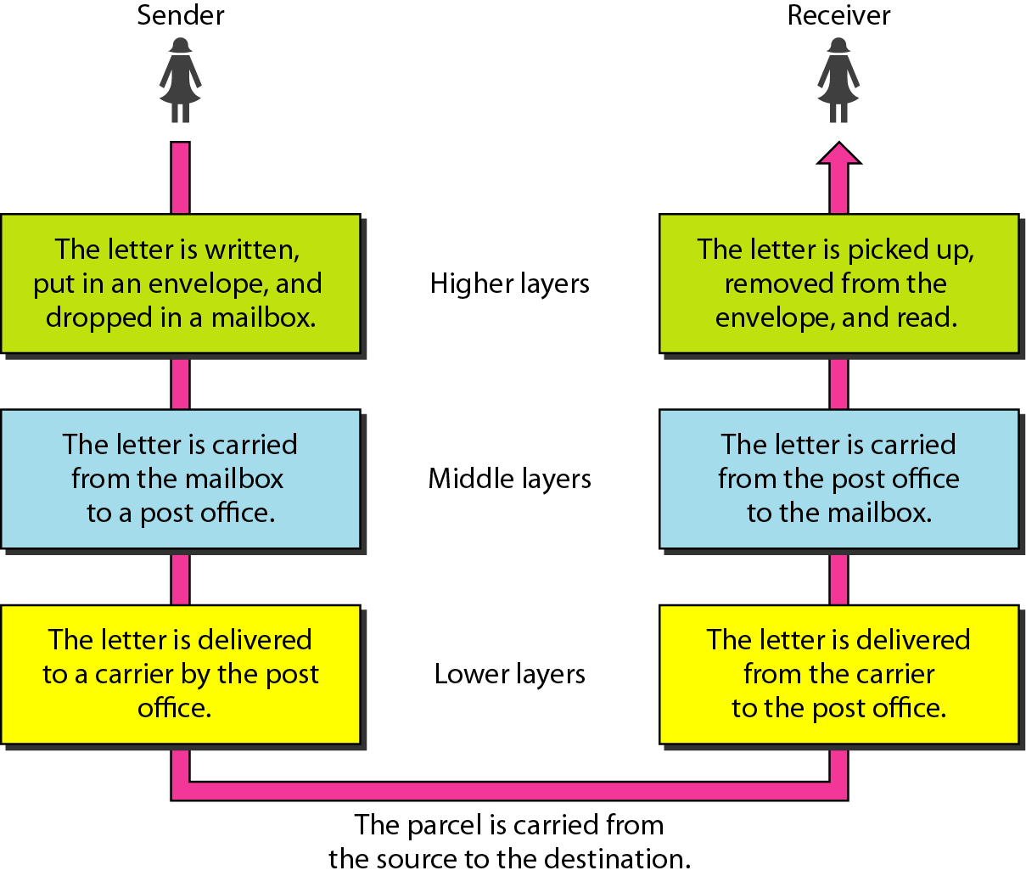
Tasks involved in sending a letter

Slide 9
THE OSI MODEL
Established in 1947, the International Standards Organization (ISO) is a multinational body dedicated to worldwide agreement on international standards. An ISO standard that covers all aspects of network communications is the Open Systems Interconnection (OSI) model. It was first introduced in the late 1970s.
ISO is an organization.
(ISO:Internation Standard Organization)
OSI is a model.
(Open Systey )

Slide 10
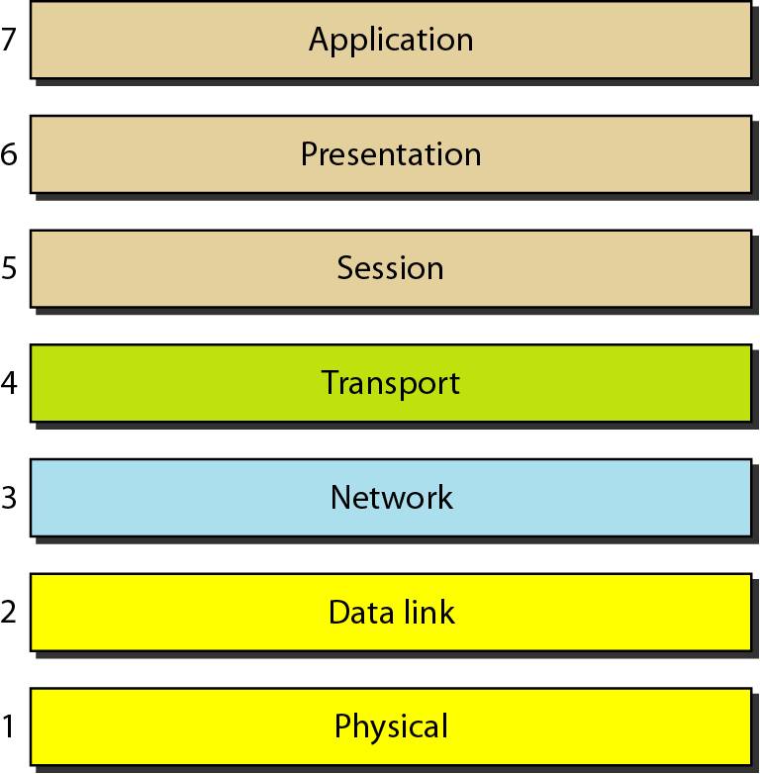
THE OSI MODEL

Slide 11
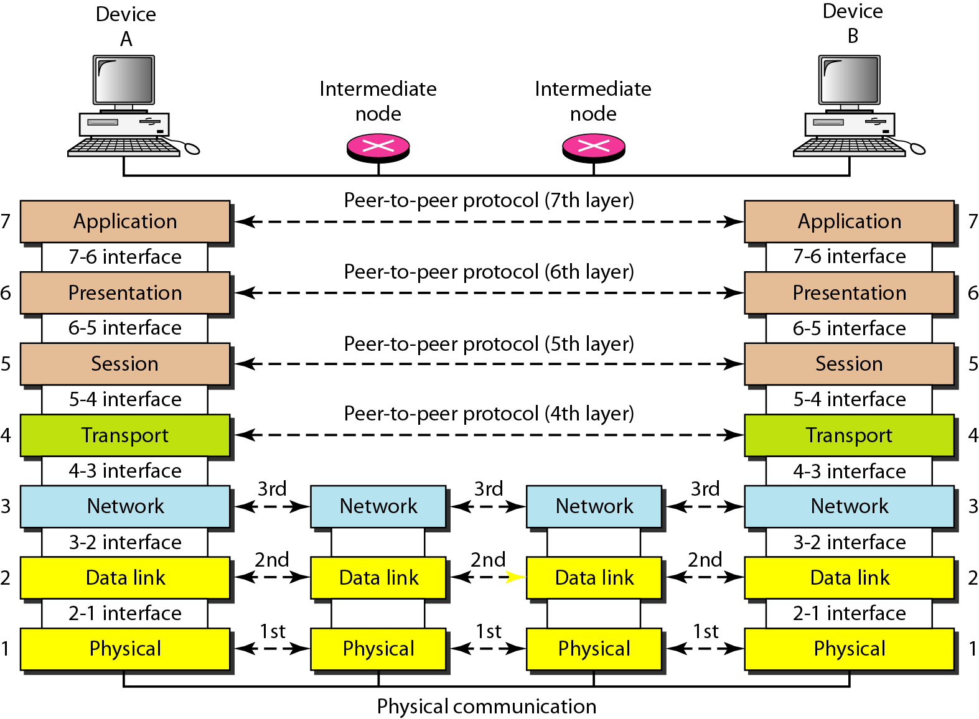
The interaction between layers in the OSI model

Slide 12
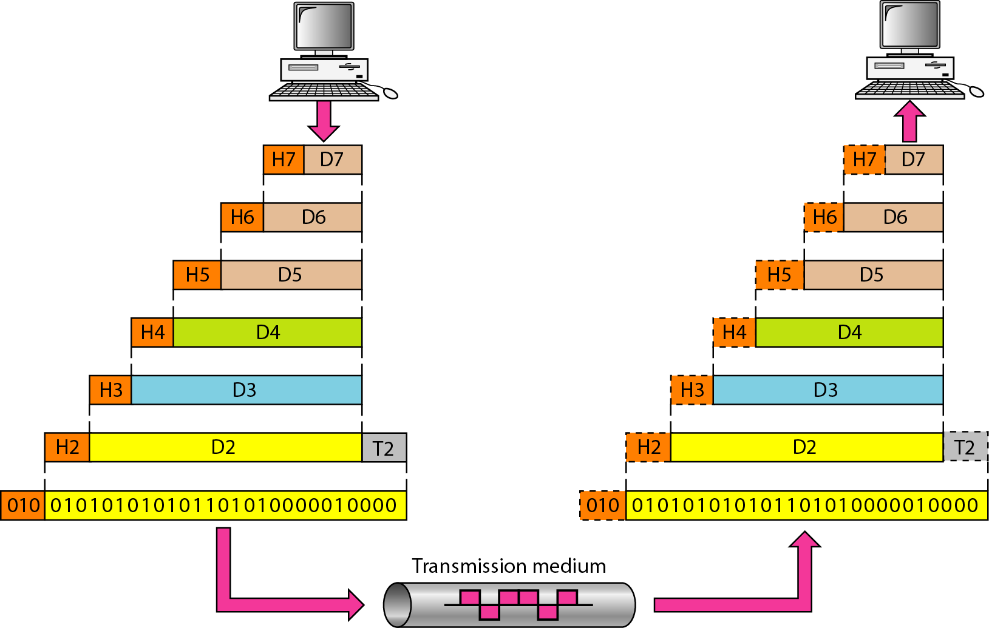
An exchange of data using the OSI model
Encapulation
Decapulation

Slide 13
Physical Charecteresyics of OSI Model Layers

Slide 14
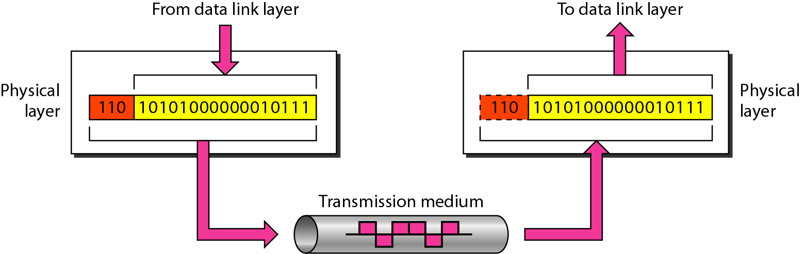
Physical Charecteresyics of Physical Layer
Responsibilities:
Modulation
Line codind
Syncronization of bits
Interface
Topology
Transmission
The physical layer is responsible for movements of individual bits from one hop (node) to the next.

Slide 15
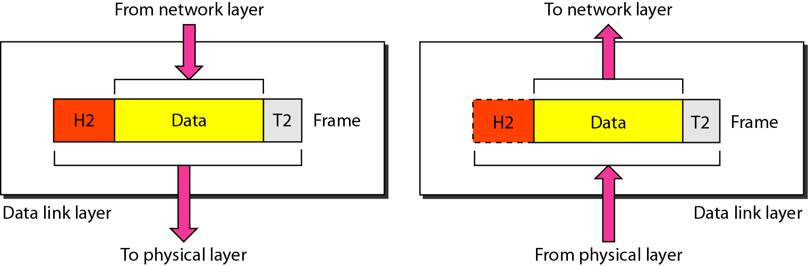
Physical Charecteresyics of Data Link Layer
Responsibilities:
Framing
Physical Addressing (07:01:02:01:2C:4B (6-bytes))
Flow Control
Error Control
Access Control
The data link layer is responsible for moving frames from one hop (node) to the next.

Slide 16
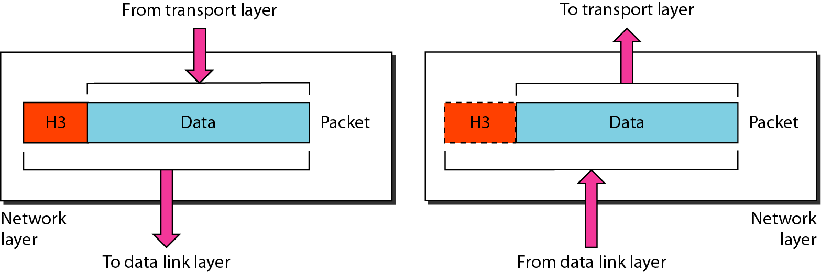
Physical Charecteresyics of Network Layer
Responsibilities:
Logical Addressing (IP addressing: IPV4 (192.172.10.2 (32-bit)) and IPV6 (AB12:23CD:45AC:123A:ACBD:1265 (128-bit))
Routing
The network layer is responsible for the delivery of individual packets from the source host to the destination host.

Slide 17
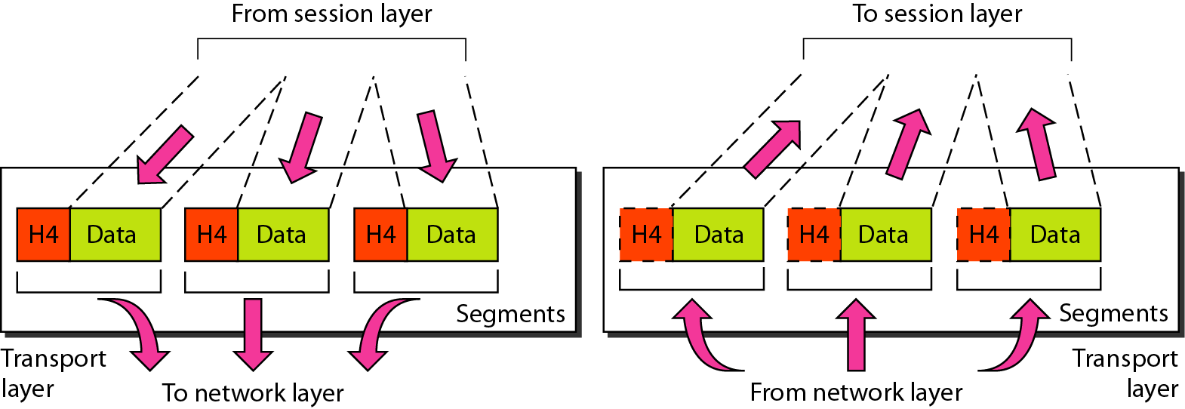
Physical Charecteresyics of Transport Layer
Responsibilities:
Source addressing (Socket addressing= IP address + Port no)
Flow Control
Error Control
The transport layer is responsible for the delivery of a message from one process to another.

Slide 18
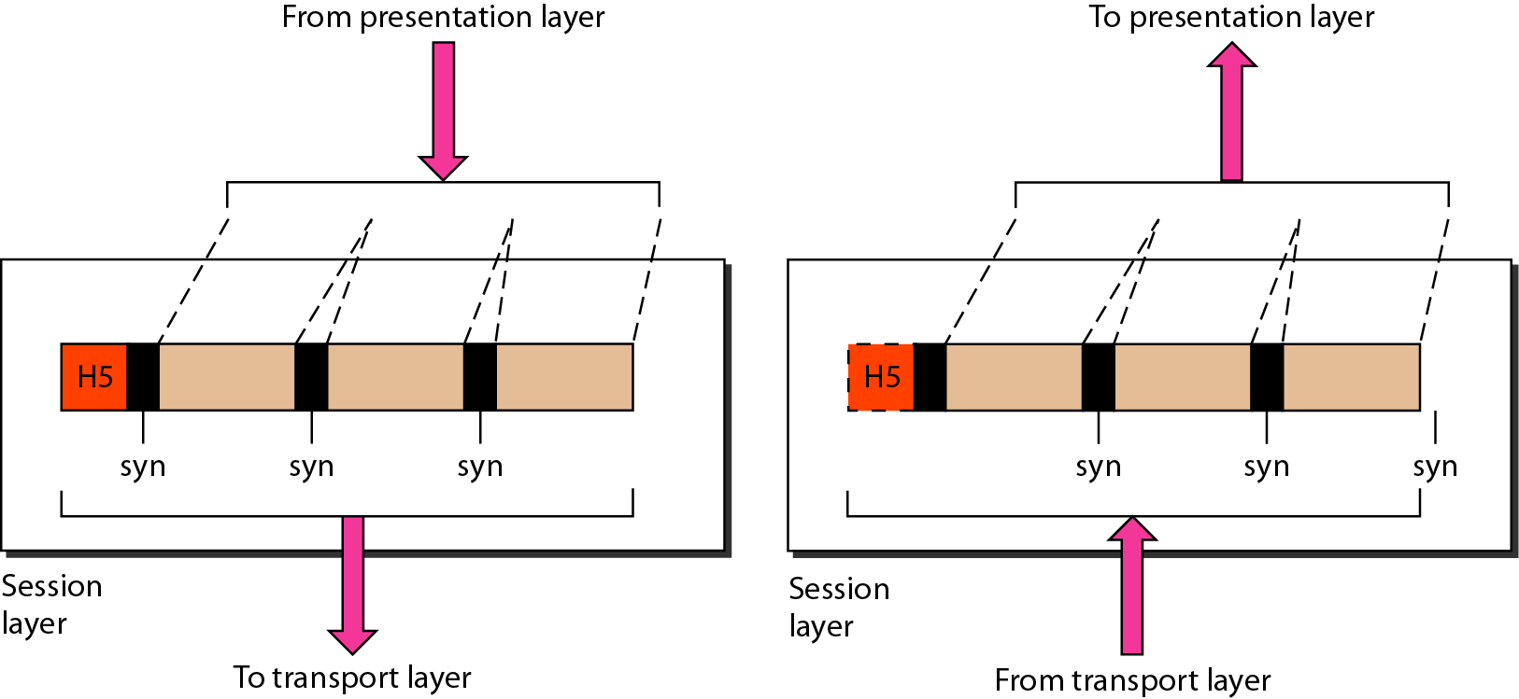
Physical Charecteresyics of Session Layer
Responsibilities:
Dialogue control
Synchronisation
The session layer is responsible for dialog control and synchronization.

Slide 19
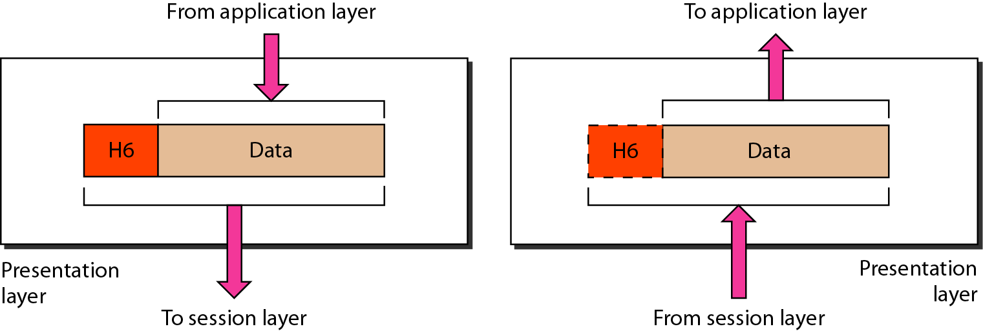
Physical Charecteresyics of Presentation Layer
Responsibilities:
Translation
Encryption
Compression
The presentation layer is responsible for translation, compression, and encryption.

Slide 20
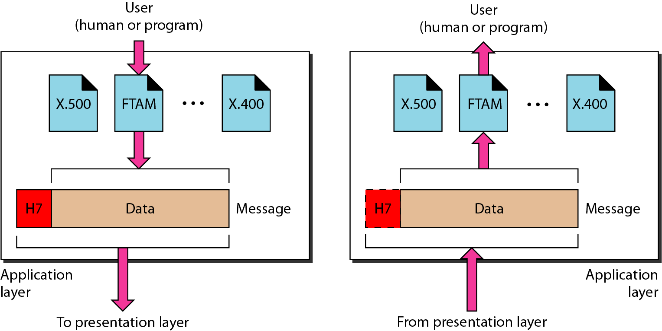
Physical Charecteresyics of Application Layer
Responsibilities:
Providing services to the end usr
HTTP (Hypertext Transfer Protocol )
FTP (File Trasfer Protocol)
SMTP (Simple mail Transfer Protocol)
The application layer is responsible for providing services to the user.

Slide 21
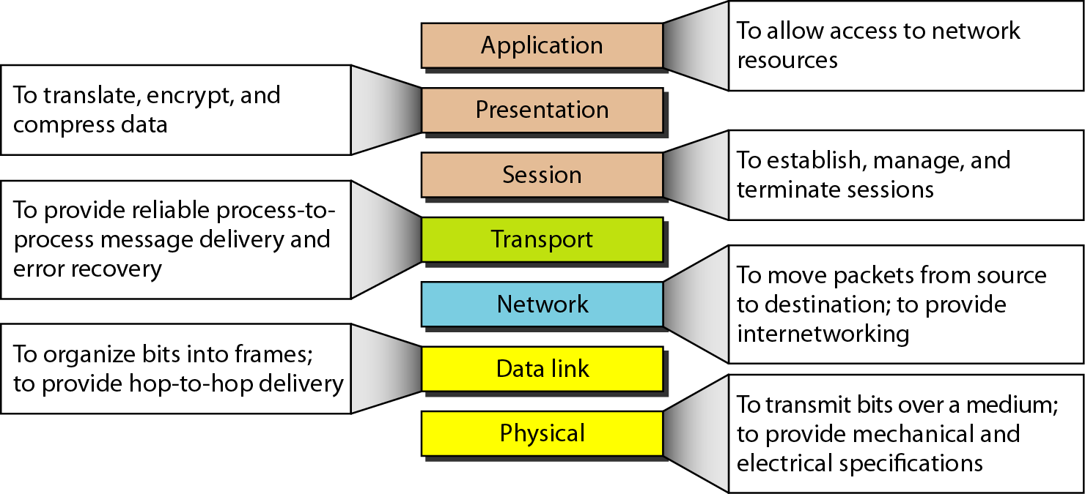
Summery of Layers

Slide 22
TCP/IP PROTOCOL SUITE
The layers in the TCP/IP protocol suite do not exactly match those in the OSI model. The original TCP/IP protocol suite was defined as having four layers: host-to-network, internet, transport, and application. However, when TCP/IP is compared to OSI, we can say that the TCP/IP protocol suite is made of five layers: physical, data link, network, transport, and application.

Slide 23
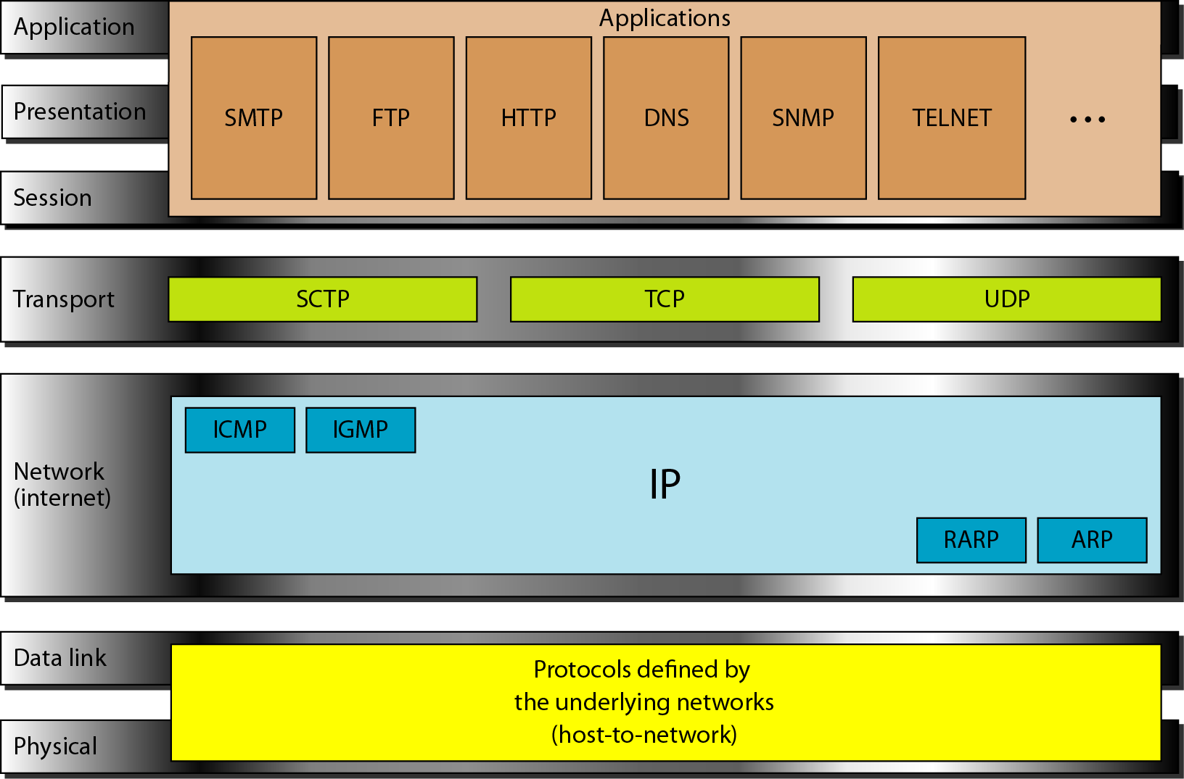
TCP/IP PROTOCOL SUITE

Slide 24
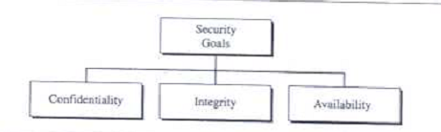
Security Goals

Slide 25
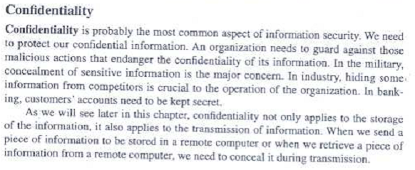
Confidentiality

Slide 26
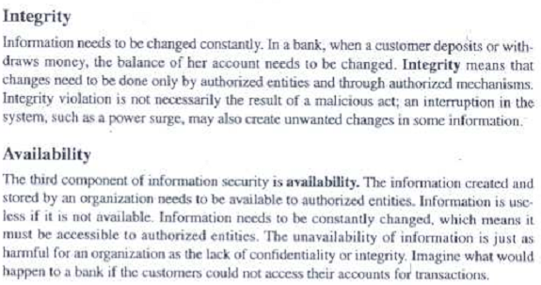
Integrity and Availability

Slide 27
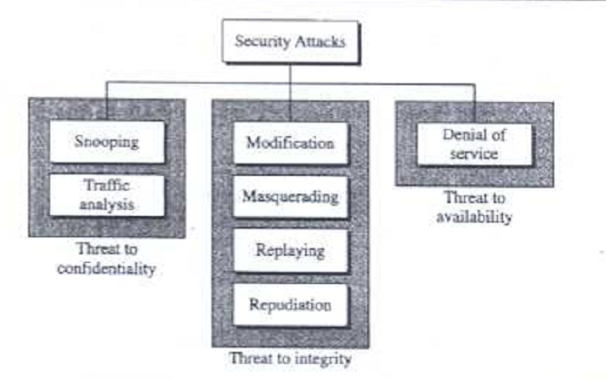
Security Attacks

Slide 28
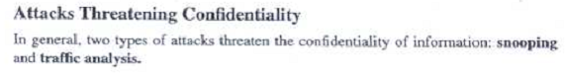
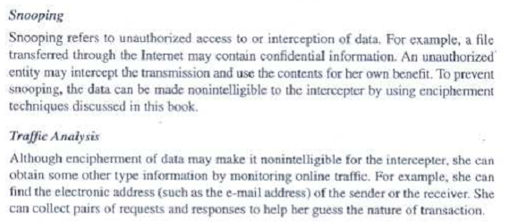

Slide 29
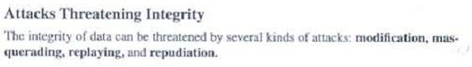
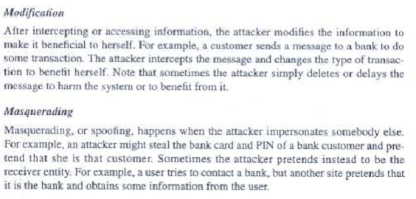
(Spoofing)

Slide 30
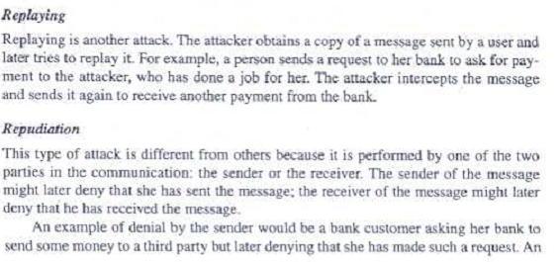
Replaying and Repudiation

Slide 31
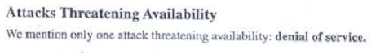
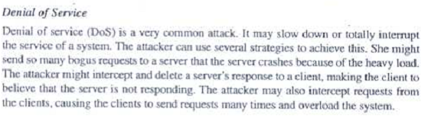

Slide 32
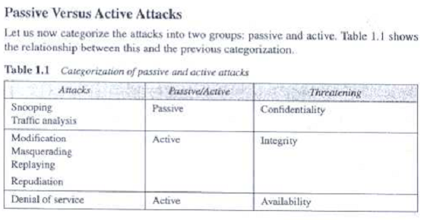
Categorization of Passive Vs Active Attacks

Slide 33
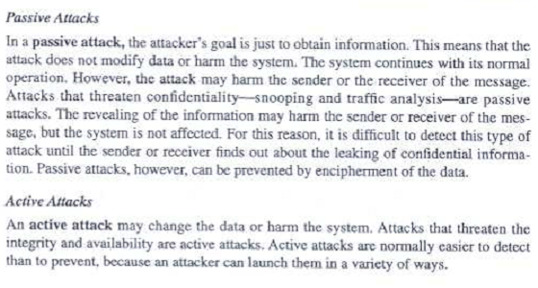
Passive and Active Attacks

Slide 35
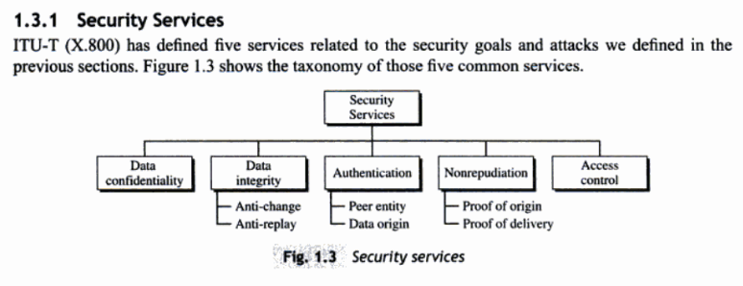
SECURITY SERVICES

Slide 36
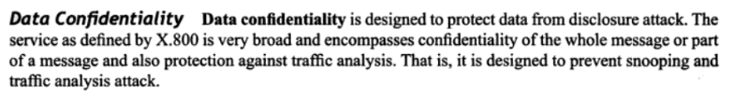
Data Confidentiality
Data confidentiality if designed to protect data from disclosure attack

Slide 37
Data Integrity

Slide 38
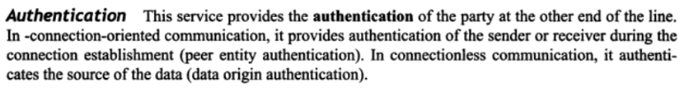
Authentication

Slide 39
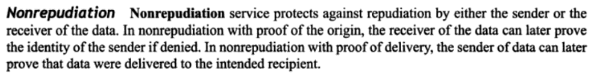
Nonrepudiation

Slide 40
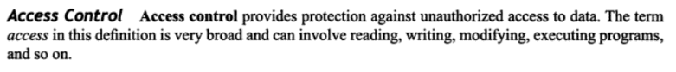
Access Control

Slide 41
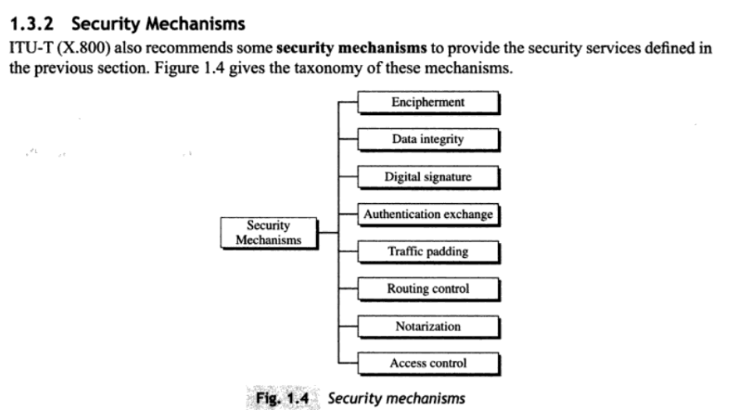
Security Mechanisms

Slide 42
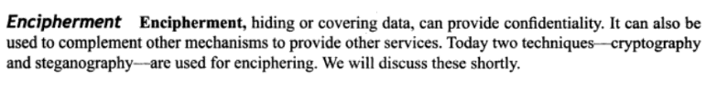
Encipgerment

Slide 43
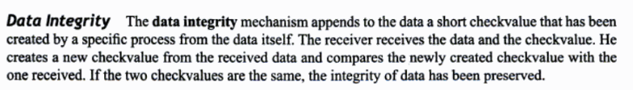
Data Integrity

Slide 44
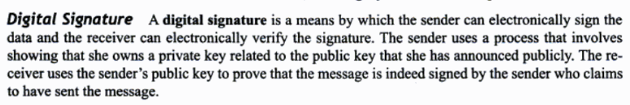
Digital Signature

Slide 45
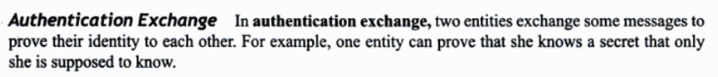
Authentication Exchange

Slide 46
Traffic Padding

Slide 47
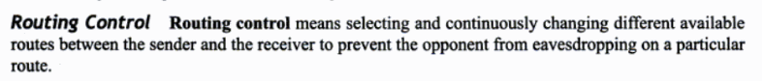
Routing Control

Slide 48
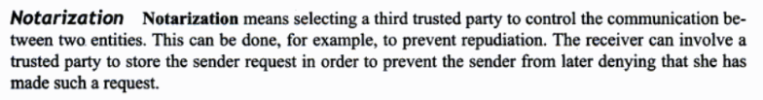
Notarization

Slide 49
Access Control

Slide 50
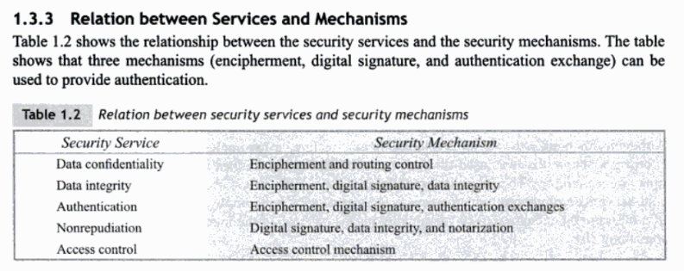
Reltion between Sevices and Mechanisms

Slide 51
TECHNIQUES
The actual implementation of security goals need some techniques
Type of Tccniques:
CRYPTOGRAPHY
Symmetric-Key Encipherment
Asymmetric-Key Encipherment
Hashing
STEGANOGRAPHY

Slide 52
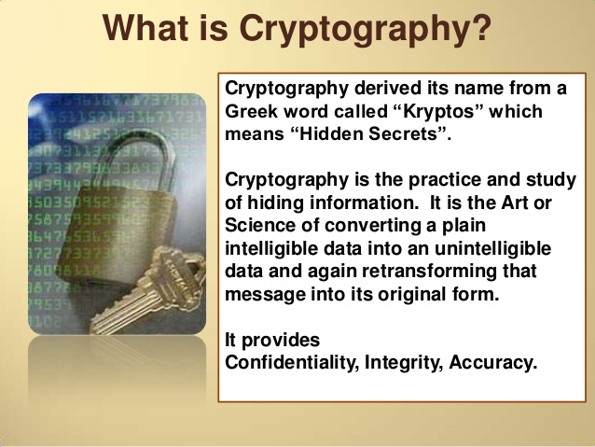
Cryptography

Slide 53
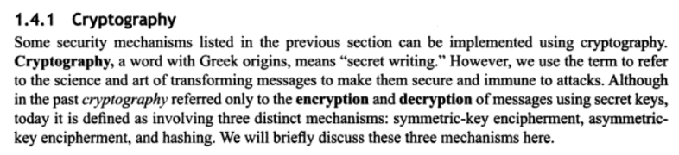
Cryptography
Cryptography means concealing the contents of message by enciphering
Steganography means concealing the message itself by covering it with something else

Slide 54
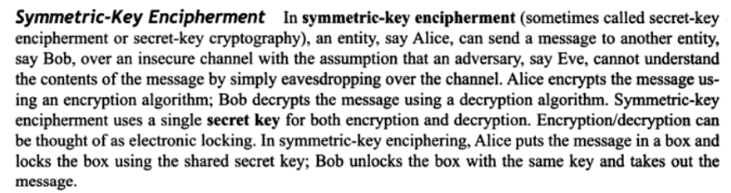
Symmetric-Key Encipherment

Slide 55
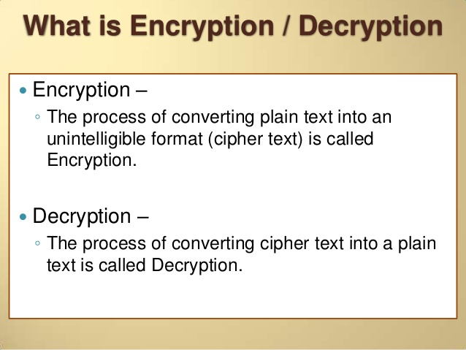
What is Encryption/ Decryption

Slide 56
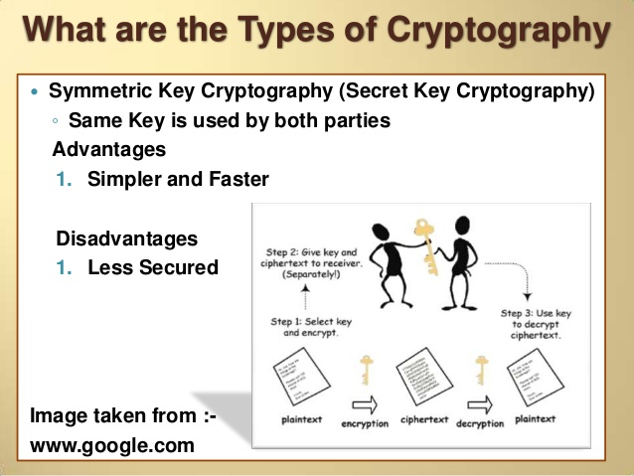
Symmentric Cryptography

Slide 57
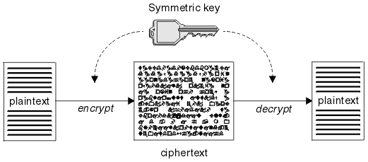
Symmetric-key Encipherment
Alice
Bob

Slide 58
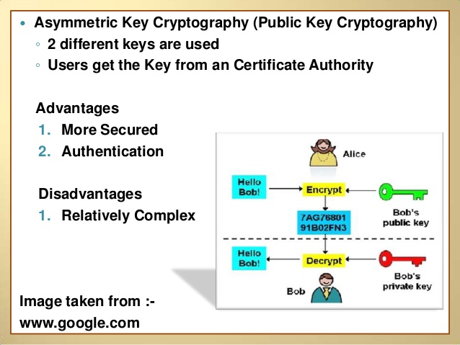
Asymmetric Key Cryptography

Slide 59
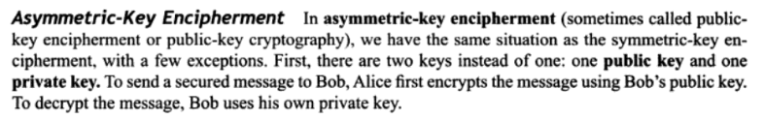
Asymmetric Key Encipherment

Slide 60
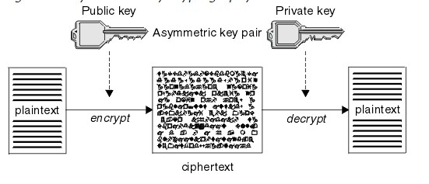
Asymmetric-key Encipherment

Slide 61
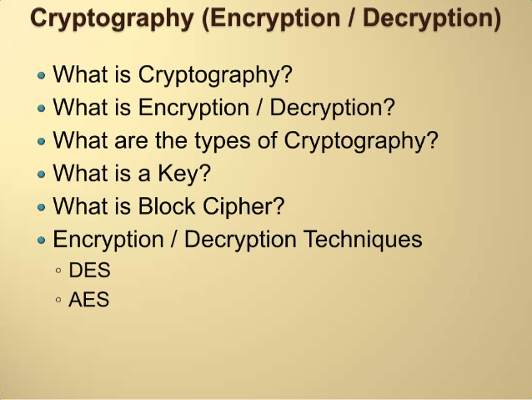
Cryptography (Encryption/Decryption)

Slide 62
Cryptography

Slide 63
Symmetric-key Encipherment
Alice
Bob

Slide 64
Symmentric Cryptography

Slide 65
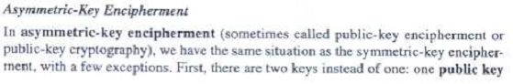

Asymmetric-Key Encipherment

Slide 66


Slide 67
Cryptography (Encryption/Decryption)

Slide 68
What is Cryptography

Slide 69
What is Encryption/ Decryption

